Slide 1
Understanding Neural Networks
Homakesavadurgaprasad
3SU2026 Model Development
05/23/2026

Slide 2
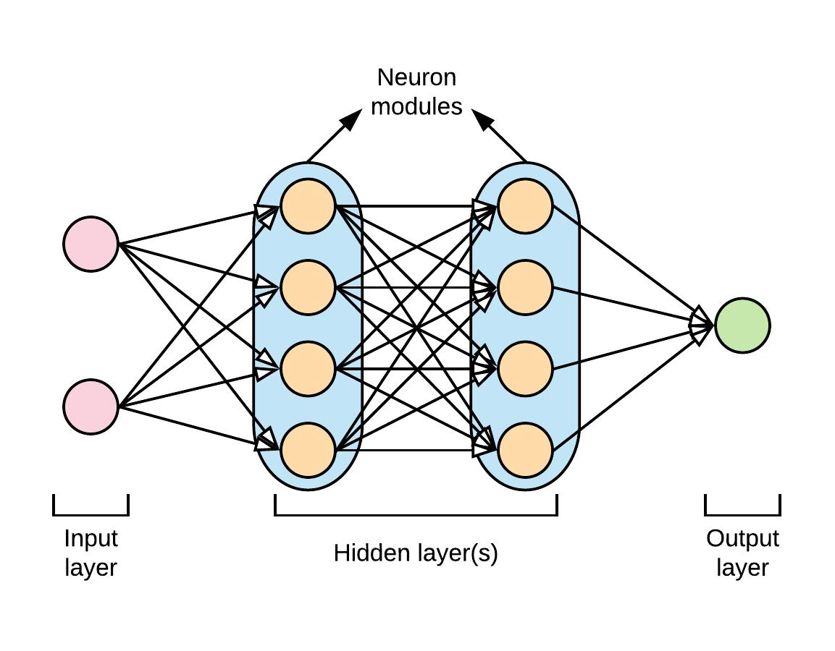
What is a Neural Network?
Inspired by the human brain, uses connected nodes instead of neurons
Learns by example, adjusts itself through trial and error until accurate .
Doesn’t need rules, it figures out patterns from data on its own
The more data it sees the smarter and more accurate it becomes
Powers modern AI chatbots, image recognition, translation, recommendations Word2Vec(used in embeddings) is itself a neural network

Slide 3
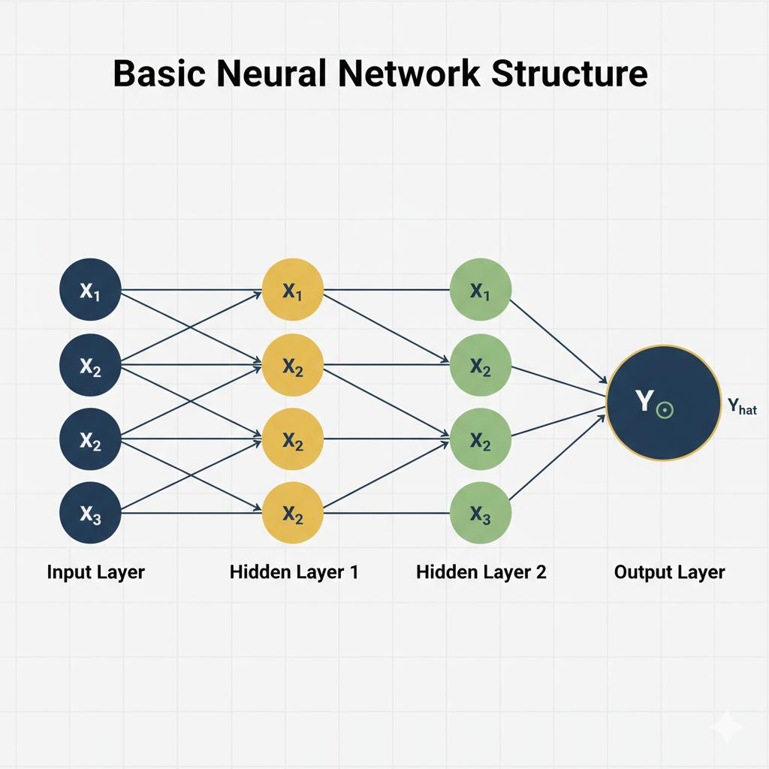
Layers in Neural Networks
Every neural network is made up of 3 main layers working together
Input layer : receives the raw data such as word, image, or number
Hidden layers: where the actual learning happens through weighted connections
Output layer: produces the final answer or prediction
The more hidden layers a network has, the deeper and more powerful it becomes

Slide 4
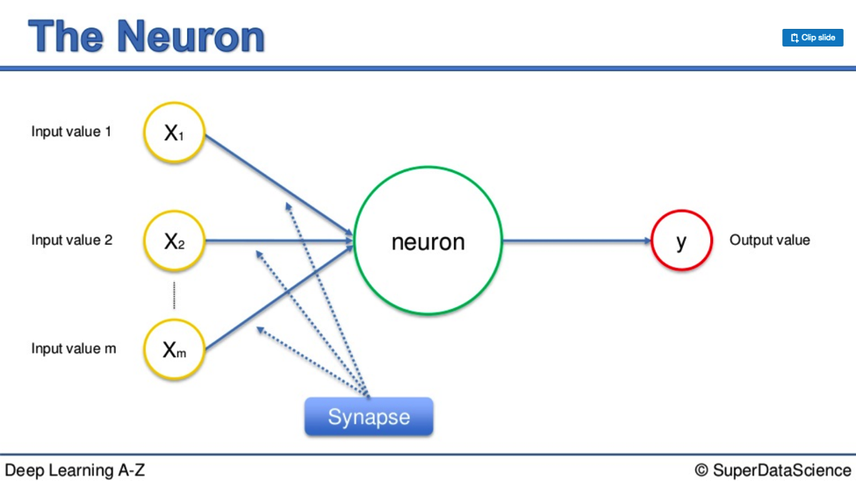
Neurons
Basic building blocks of a neural network
Receives input, process it, and pass the result forward
Connected through weighted links, weights decide how much influence each connections has
When signal is string enough, the neuron activates and passes information forward.
Millions working together allow the network to learn complex patterns

Slide 5
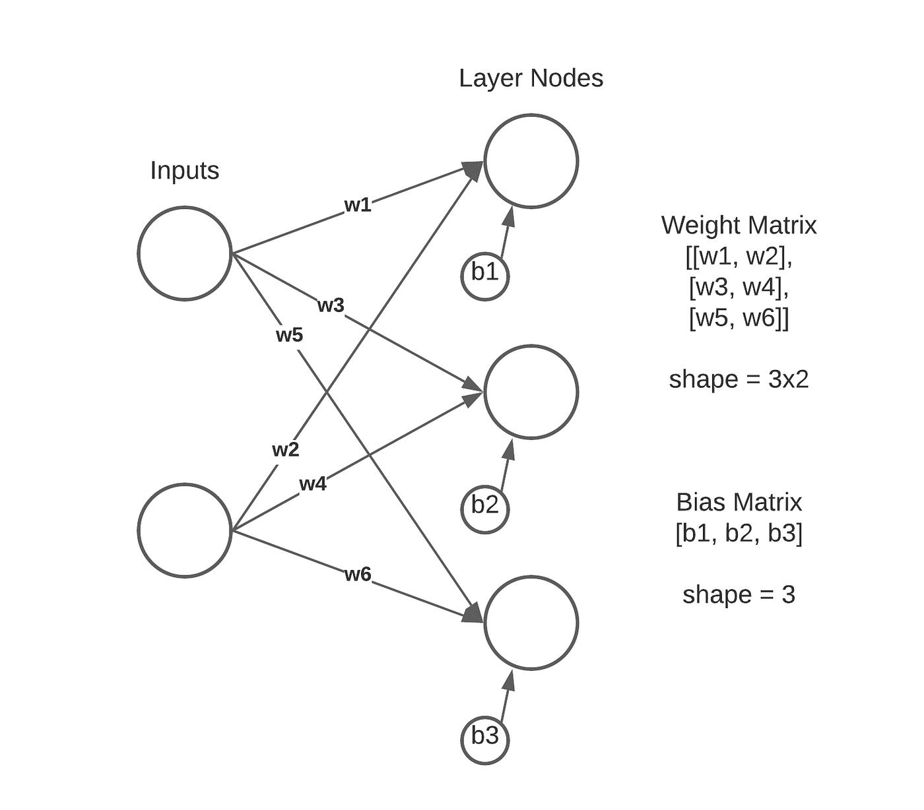
weights
Weights are numbers that control the strength of connections between neurons
They decide how much influence one neuron has on the next
When a network is first created, weights start as random numbers
During training, weights are constantly adjusted to reduce mistakes
The process of adjusting weights is called backpropagation
Getting the weights right is what allows the network to learn and make accurate predictions

Slide 6
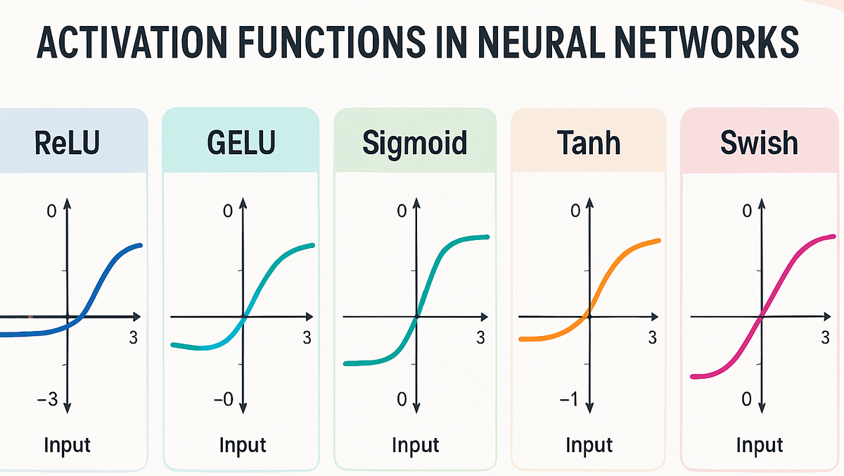
Activation Functions
Decide whether a neuron should activate or not
Without them the network could only learn simple straight-line patterns
Applied after each neuron processes its input
Common types:
ReLU – outputs zero if negative, keeps the value if positive
Sigmoid – squishes output between 0 and 1
Softmax – converts outputs into probabilities

Slide 7
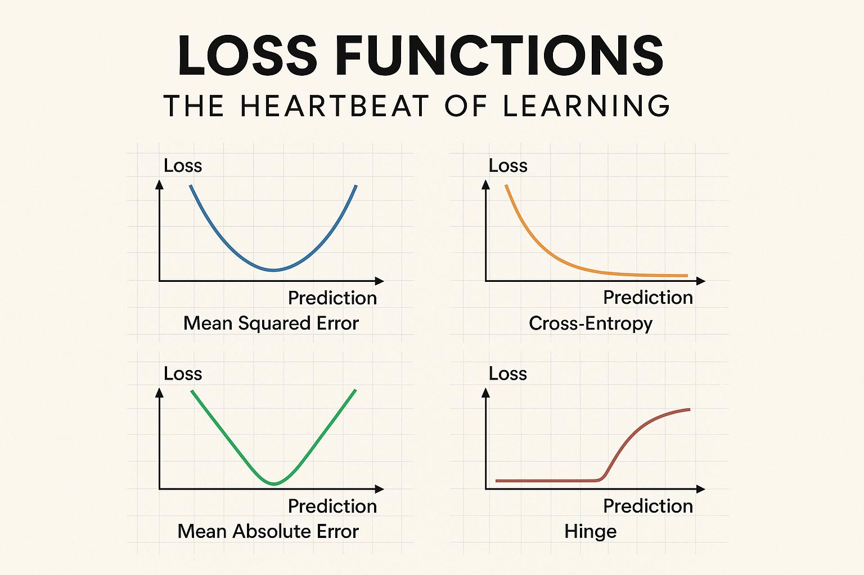
Loss functions
Measures how wrong the networks prediction is
The higher the loss, the worse the prediction
The goal of training is to make the loss as small as possible
Types:
Mean squared error(MSE) – used for number prediction problems
Cross Entropy – used for classification problems

Slide 8
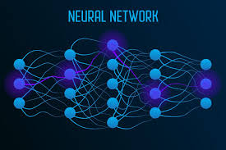
Optimization Algorithm
Used to reduce the loss by adjusting the weights after each mistake
They figure out which direction to adjust weights to improve accuracy
The most common method is called Gradient Descent
Learning rate controls how big or small each adjustment step is
Types:
SGD(Stochastic Gradient Descent) – updates weights after every single example
Adam – most popular today, adjusts learning rate automatically for faster learning
RMSprop – works well for problems where data changes over time

Slide 9
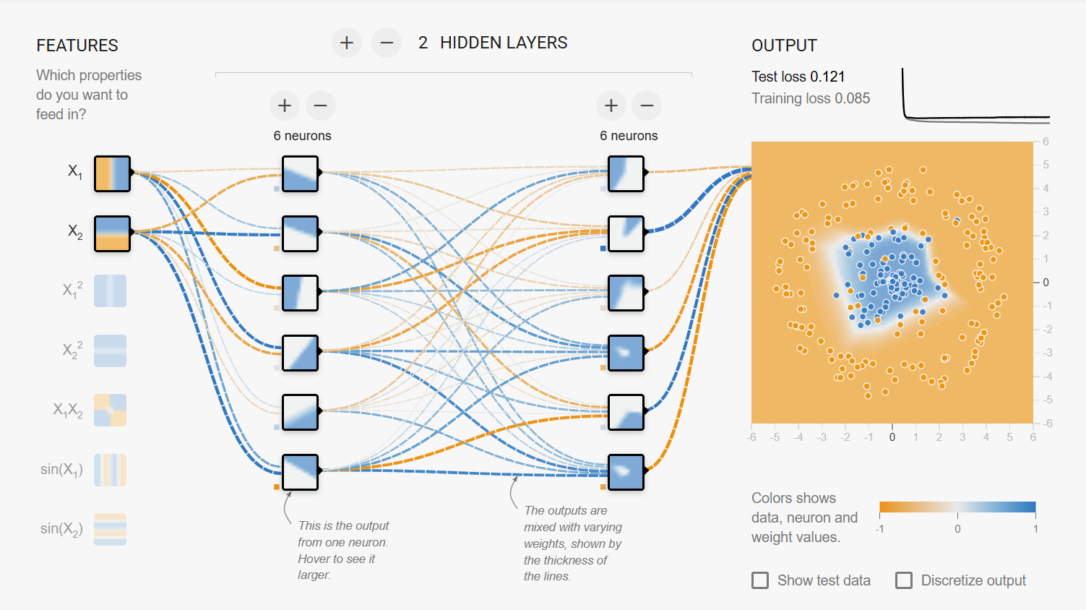
Neural Network Architecture Diagram
Input Data
Hidden Layers
Output Prediction

Slide 10
Summary
Neural networks learn from data by adjusting connections through trial and error
Neurons are organized into layers that receive, process, and output information
Activation function add complexity while loss functions measures how wrong prediction is
Optimization algorithm like Gradient Descent and Adam reduce errors by fine tuning weights
Tools like the TensorFlow embedding projector make it easier to see how AI learns and groups information

